Slide 1
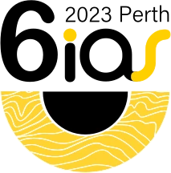
Visualisation and interaction methods for 3D phenomena
Mark Lindsay – CSIRO
3D modelling and Loop workshop
6th International Archean Symposium, Fremantle / Walyalup

Slide 2
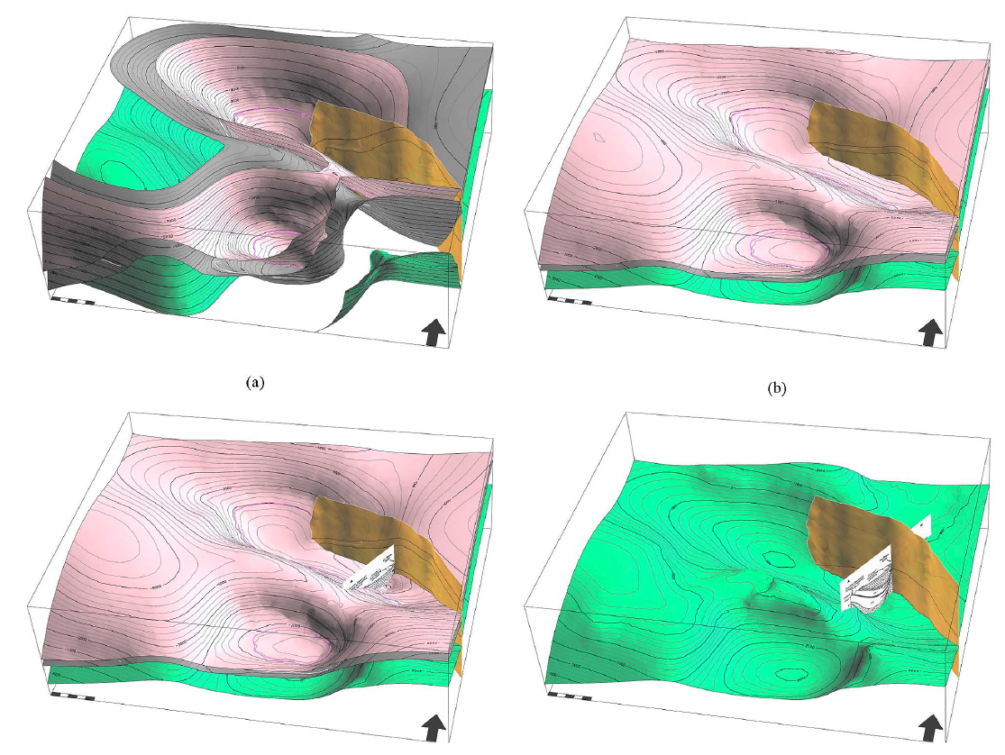
Overview
History
Current techniques and difficulties
Sharing
Interaction
Multiple models
Other free / open source resources
Concluding remarks
Modelling of La Popa Basin, NE Mexico
Caumon et al. 2013

Slide 3
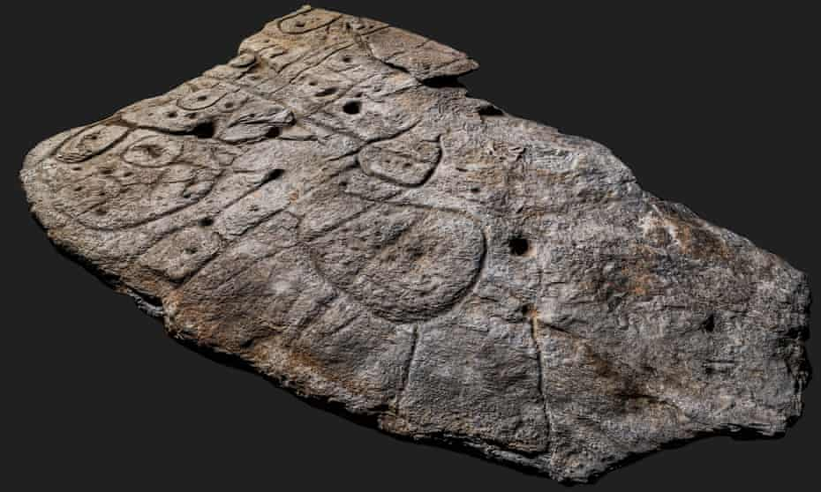
History
Purpose
Practical
Scientific curisosity
Communication
Scaling
Perfect representation of nature, or more to communicate ideas?
Saint-Belec slab - 2.2-metre by 1.53-metre stone
4000 year-old etchings of topography, western Brittany
The Guardian, April 7, 2021
Photograph: Denis Gliksman
Notes:
Topographic map with hills and rivers.
stone represent the Odet River and its valley – 80% resemblance to an 29 km stretch

Slide 4
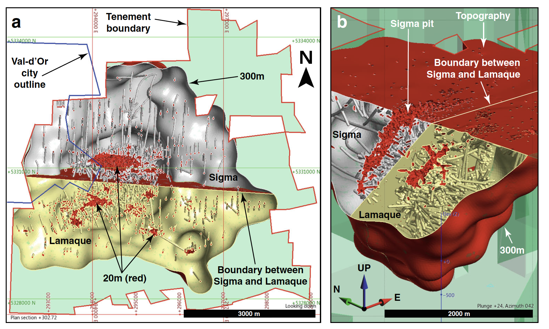
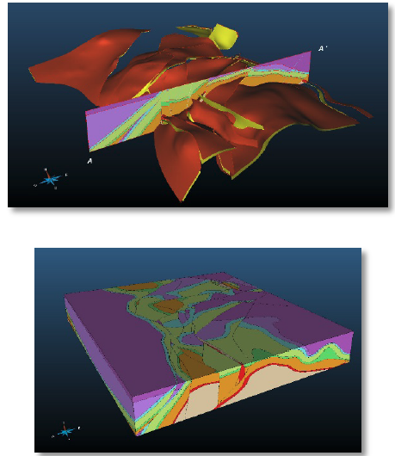
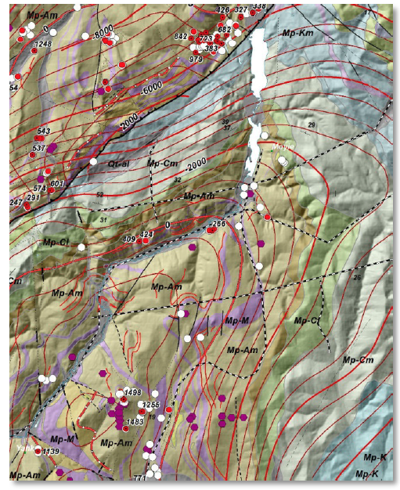

Visual summary
Simplify nature
Cowan 2020
Sigma-Lamaque Au deposit, Canada
De Kemp et al 2017
Purcell Anticlinorium, Southeastern British Columbia

Slide 5
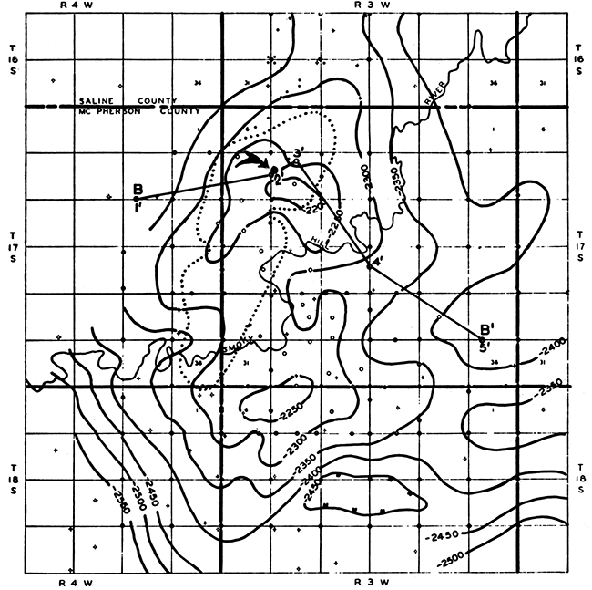
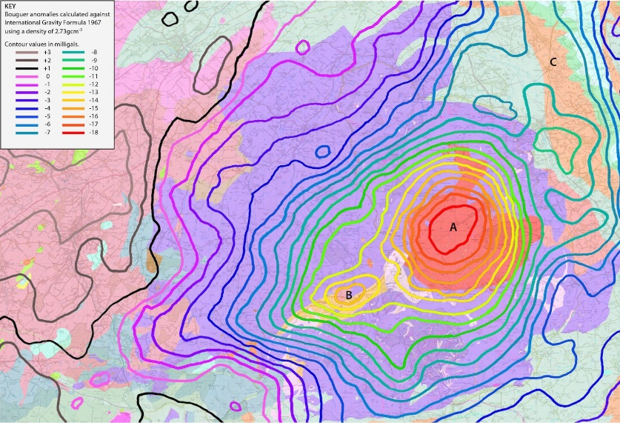
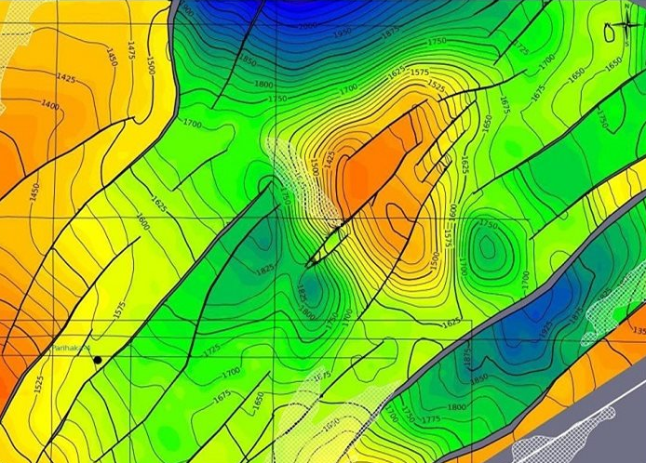
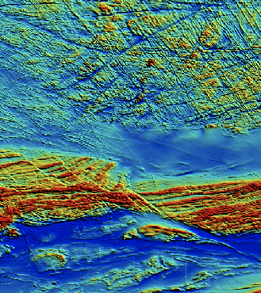
Progression – geophysical grids (really models)
Hand-drawn
Auto-contour
Grid interpolation
Blends, sun-shades,
colour-mapping
Depth contours (seismic)
www.kgs.ku.edu, Bulletin #137
Bouguer anomaly contours
www.geologynorth.uk
Depth grid and contours (seismic)
www.pgdm.com “SeisEarth”
Magnetic
c.f. GSWA
Grav and mag blend
Lindsay et al. 2020

Slide 6
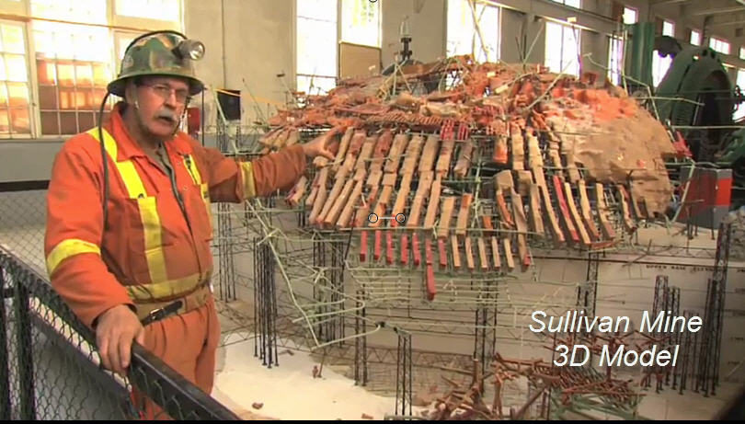
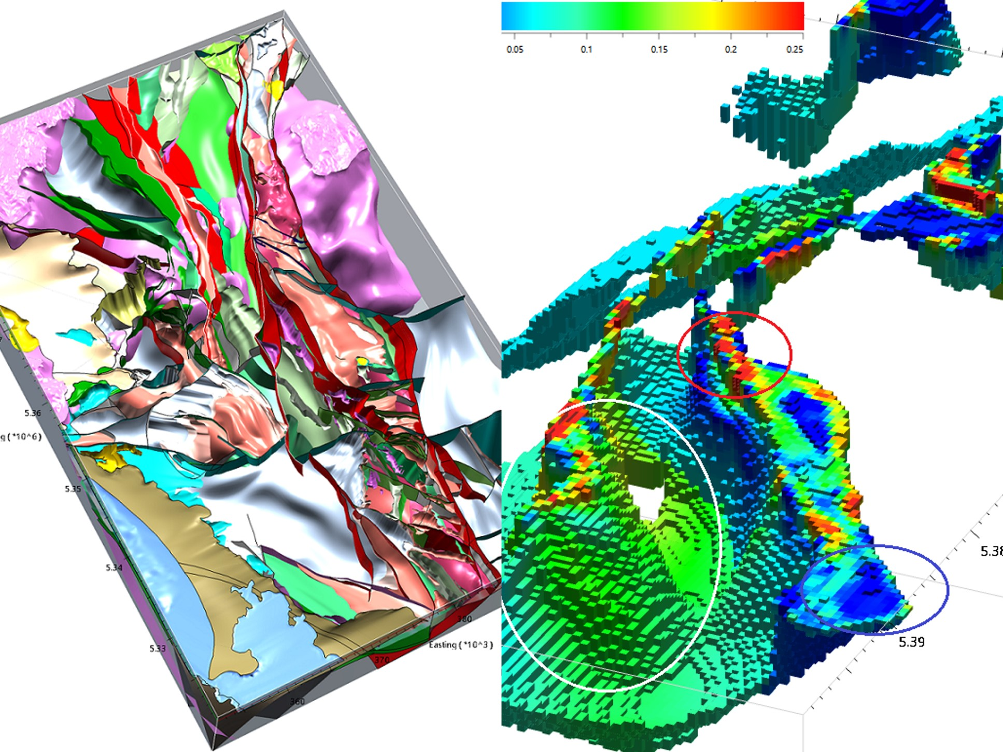
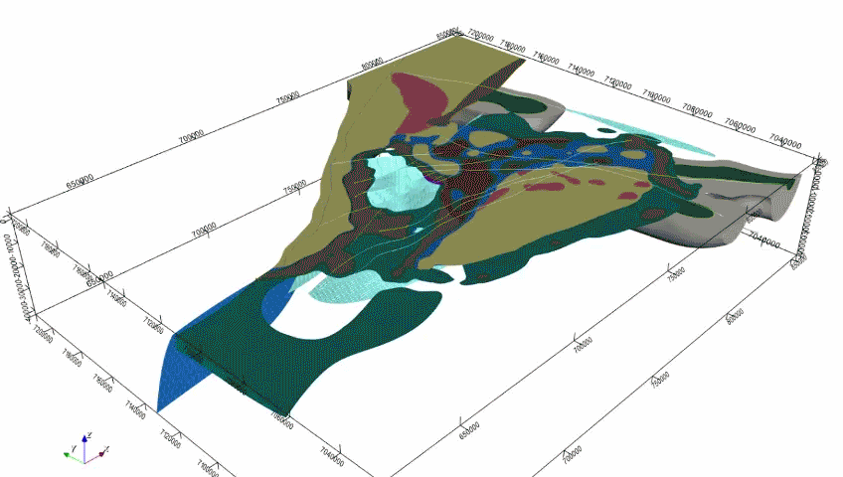
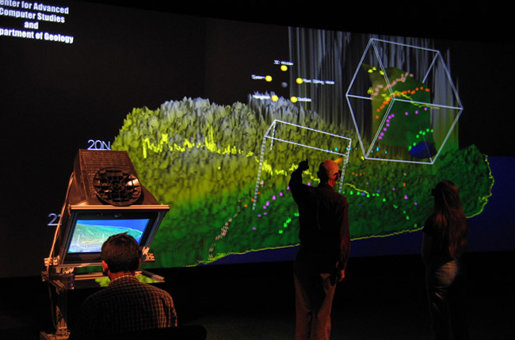
Progression – 3D models
Explicit
Saint-Belec slab
guardian.co.uk
Implicit
Sullivan Mine Model
Thanks to E. De Kemp
W. Tasmania
MRT
Yerrida Basin, West. Aust.
Lindsay et al 2020
Collaborative VR (‘Kvasir-VR’)
vrlab.cmix.louisiana.edu

Slide 7
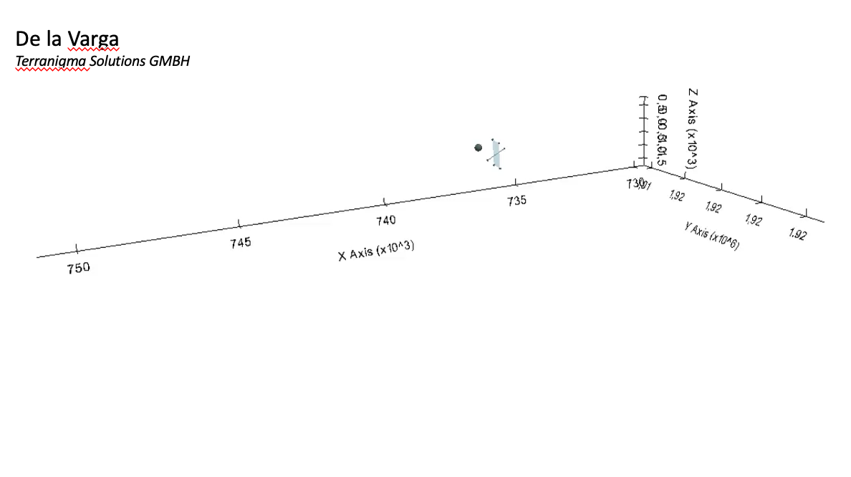
Current practice
Points (0D)
Curves (1D)
Surfaces (2D)
Volumes (3D)
Time (+1D)

Slide 8
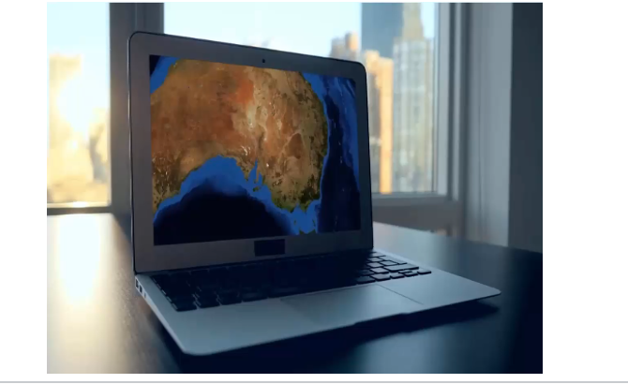
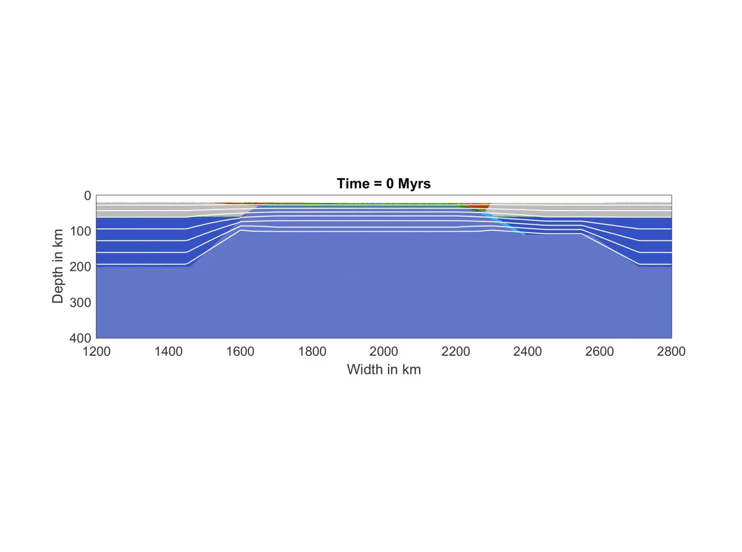
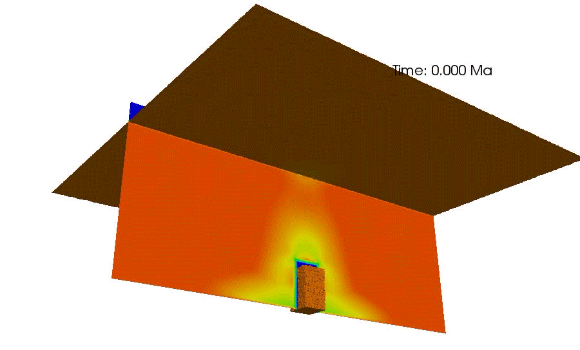
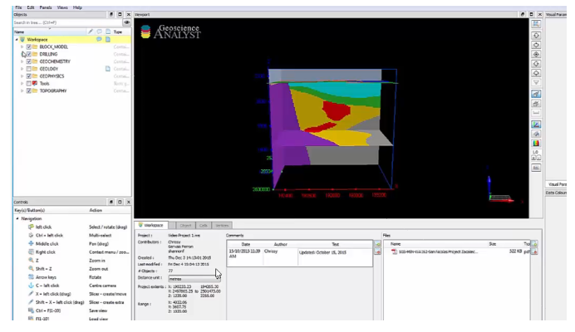
Current practice
EarthSci (Geoscience Australia)
Data discovery
Geodynamic models
Kohanpour et al. 2017
Examining tectonic scenarios using geodynamic
numerical modelling: Halls Creek Orogen, Australia
Geoscience Analyst (MIRA)
Editing, modelling
Gorczyk and et al. 2017
Intrusion of Magmatic Bodies Into
the Continental Crust: 3‐D Numerical Models

Slide 9
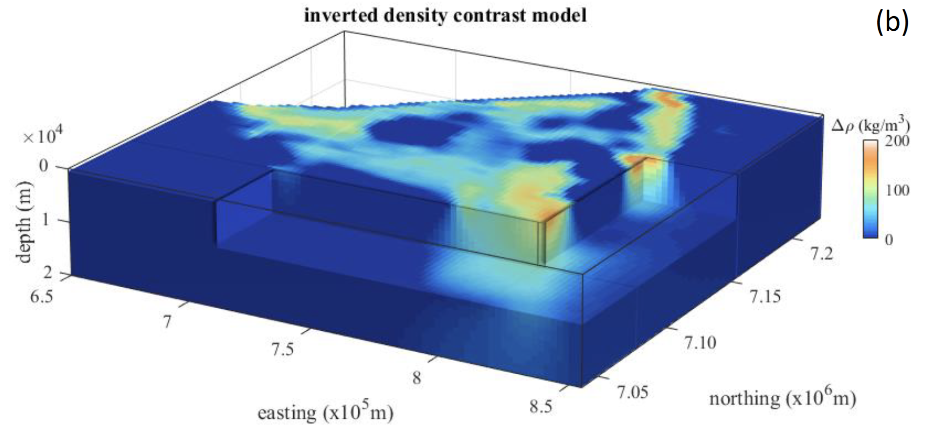
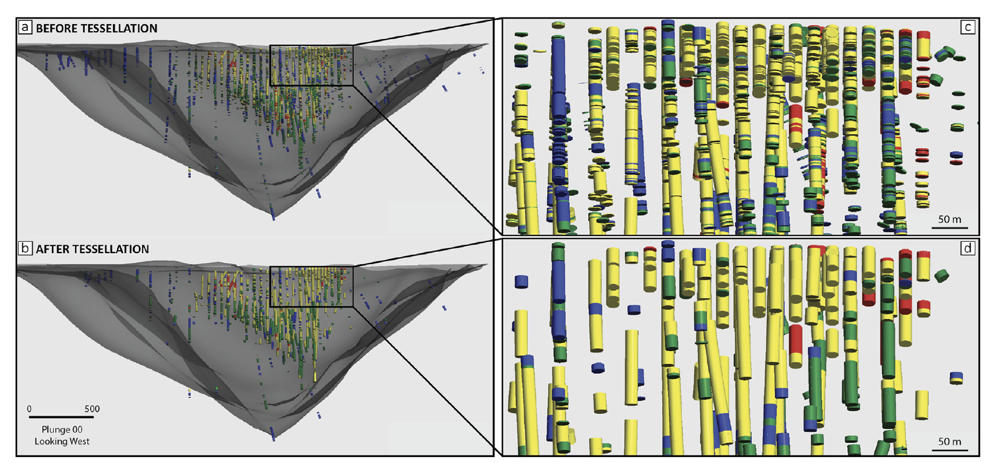
Current practice
Giraud et al 2018
Yerrida Basin, WA, density model
Difficulties of presenting 3D with a 2D medium
Le Vailant et al 2017
Kevitsa Mine, drill hole tessellation
Pakyuz-Charrier et al 2018
Mansfield, Victoria

Slide 10
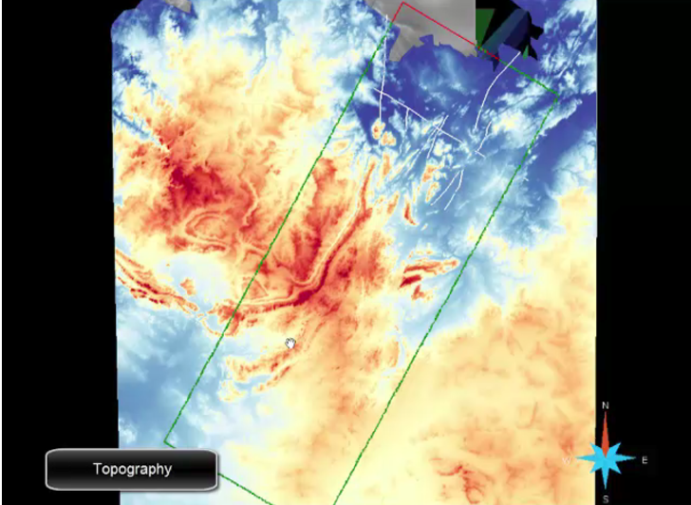

Current practice
Difficulties of presenting multivariate model inputs with their results

Slide 11
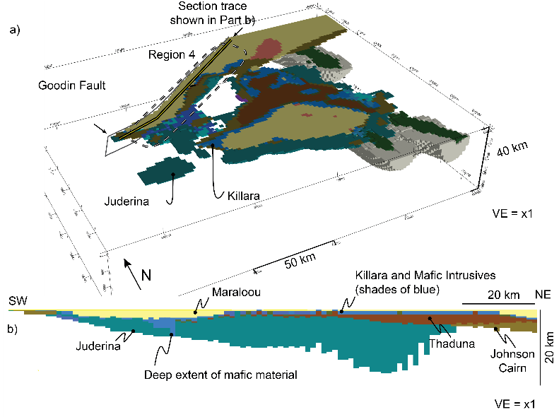
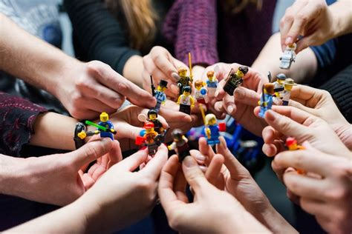
Visualisation ~ Communication
Models (inc. 3D) need to be predictive or generate inference
Requires interaction and sharing between participants
Collaboration
Scenarios for robust decisions
help us investigate our assumptions;
highlight important processes and decision points;
engage different stakeholders;
provide insight into what is possible
provide visions of the future which motivate actions toward a desirable goal or away from an undesirable one;
communicate complex information to non-scientific audiences
Lindsay et al 2020
Solid Earth
Bonnie McBain - https://i2insights.org/2019/07/02/designing-scenarios-for-decisions/
John Sykes – Greenfields Research/MinEx Consulting
Rhys-Davies et al. 2020a,b
hsdinstitute.org

Slide 12
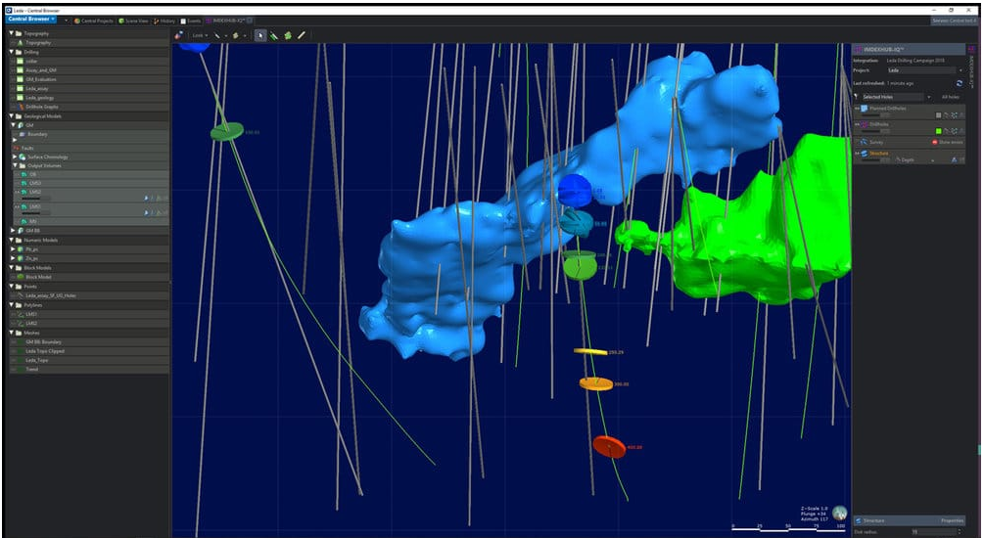
Interaction and sharing
Data and model management
Common repository
Version control (both data, model and predictions)
Leapfrog (Seequent) Central
IMDEXHUB-IQ
runtime drilling monitoring
Avoiding uncertainty
Linguistic uncertainty
Vague aims
Ambiguity and underspecified comms.
Stakeholder members / composition
Value uncertainties
Agreement/disagreement on quantification, comparison and value of social goals, trade-offs, objectives
Ill-defined terms-of-reference and scope is a significant and difficult to mitigate source of uncertainty (Quigley et al. 2018)
Browser window

Slide 13
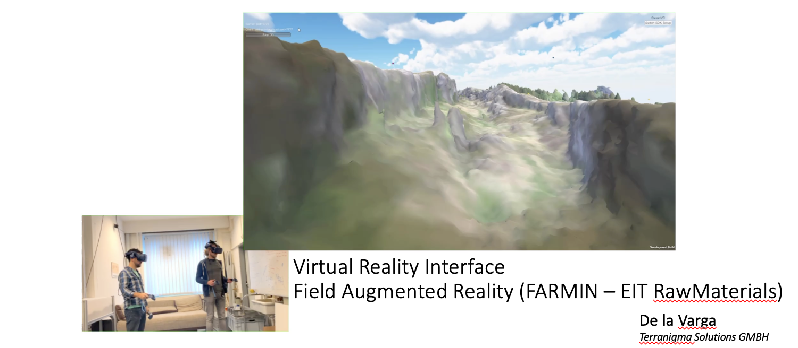
Interaction and sharing

Slide 14
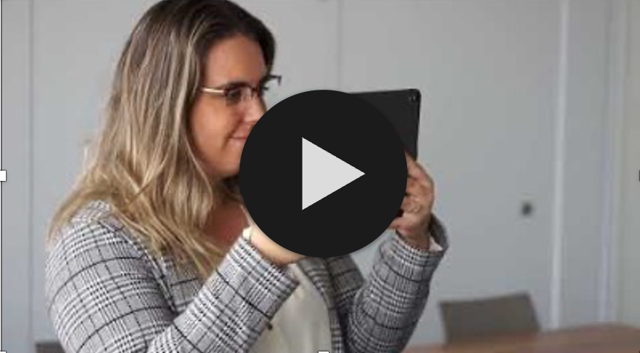

Interaction and sharing
cloud-based
visualize, edit and communicate geological data
models in intuitive 3D
real-time collaboration across multiple devices
Liquid Earth – Terranigma Solutions
https://www.terranigma-solutions.com/

Slide 15
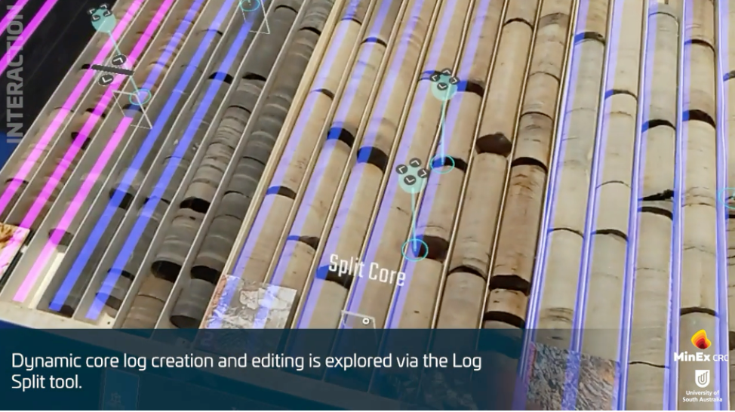

Interaction and sharing
Exploration Metaverse:
augmented reality core logging (LogAR),
virtual collaboration and visualisation of spatial datasets (OzMap),
immersive analytics for geoscientific data (ImAxesGEO).
Tom.Raimondo@unisa.edu.au
https://www.projectlive.org.au/exploration-metaverse

Slide 16
Interaction and sharing
Multiple separate realisations
Multiple models
Suzuki et al. (2008)
Multiple separate interfaces (cross-section)
Multiple models (3D)
De La Varga (2018)
Mallet and Tertois (2010)
From Wellmann and Caumon (2019)

Slide 17
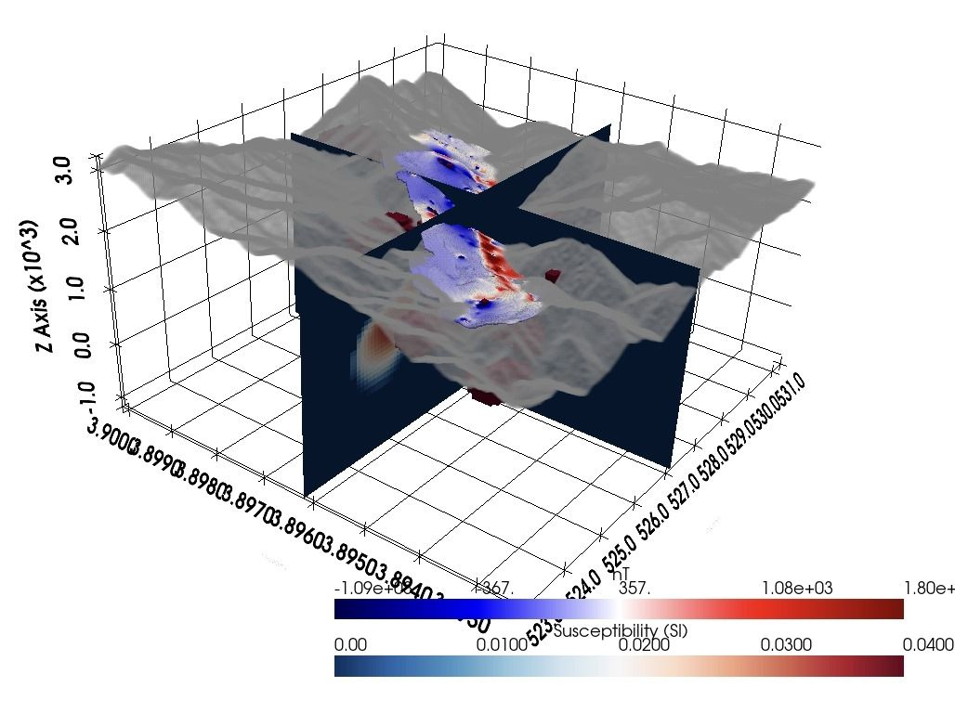
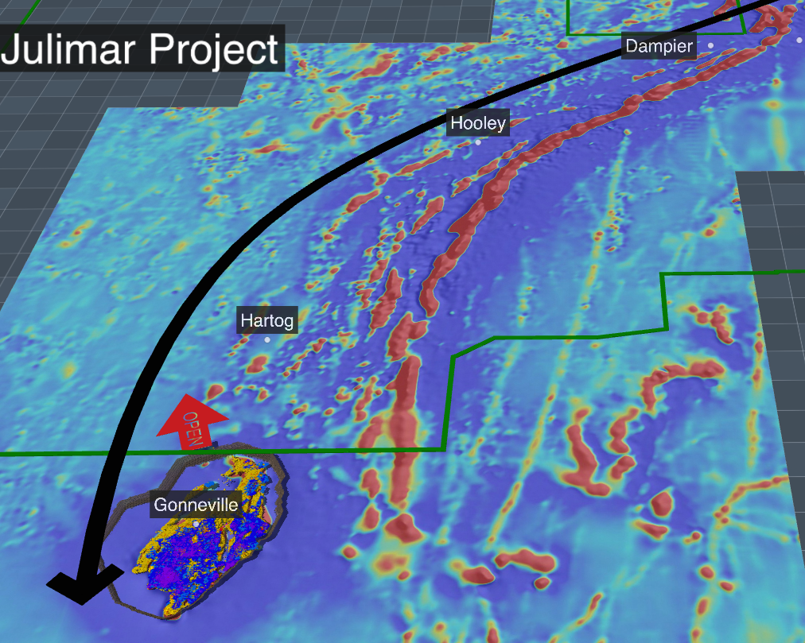
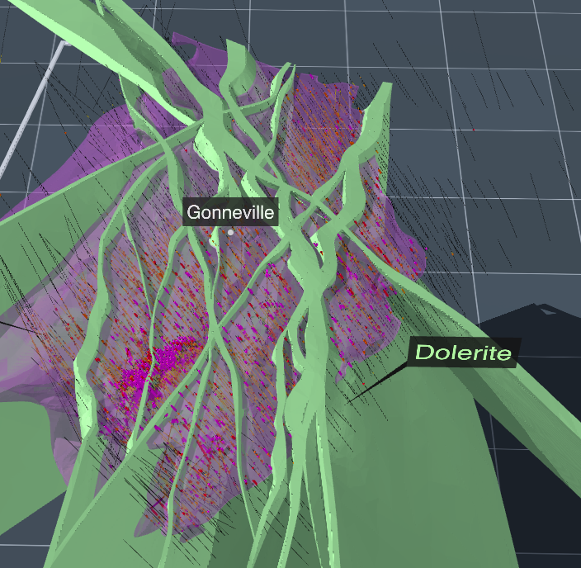
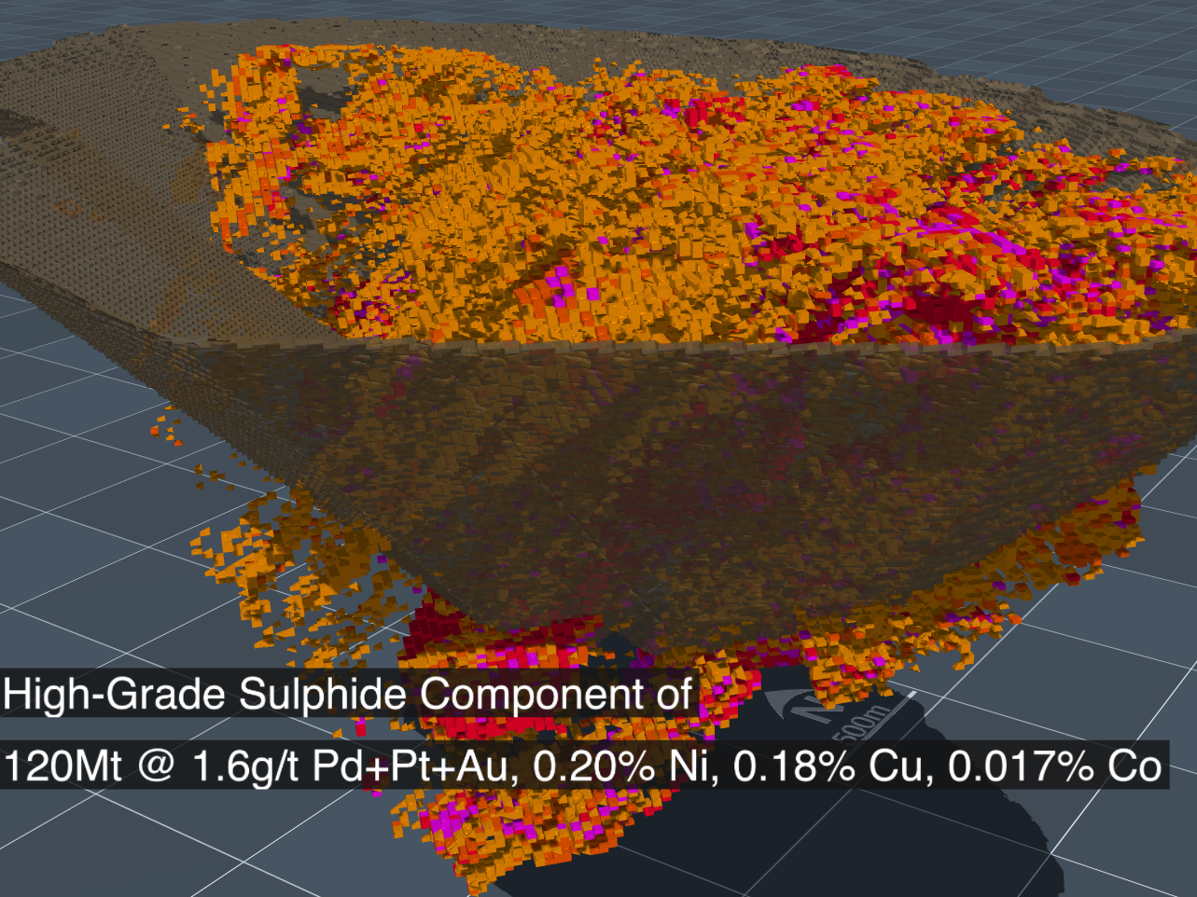
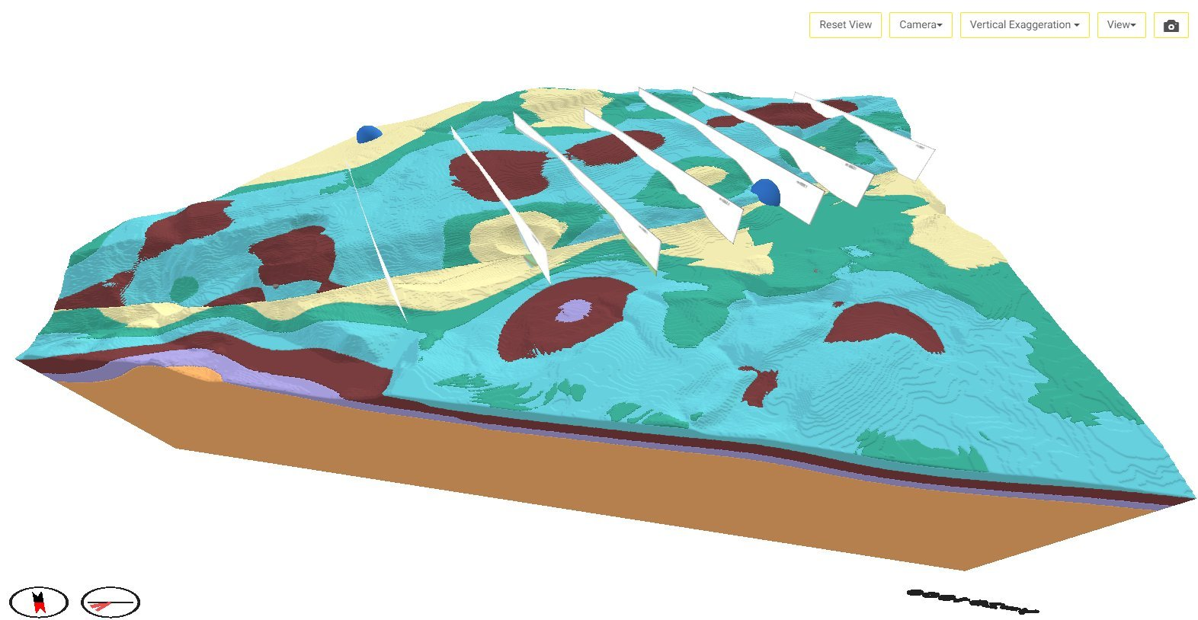
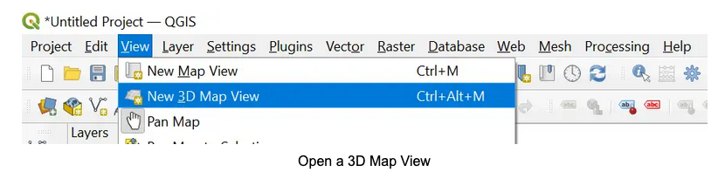

Other free or open source resources
pyvista.org (with VTK)
Receiver locations and geophysical data are mapped over a 3D model.
Paraview, VisIt
https://inventum3d.com/
Geoscience Analyst
QGIS
c/o Hakim
https://www.visualkarsys.com/
Visual Karsys
Swisskarst project (2010-2014) Swiss National Science Fundation
March 2023

Slide 18
Concluding remarks
Visualisation is more than just a solo exercise
Communicating with our collaborators and stakeholders
Avoiding uncertainties and misunderstandings
Modelling
Interactive
Collaborative
Joint visualization and construction

